Slide 1
Servo Robot Arm
Brandeis Robotics Lab

Slide 2
Existing Robot Arm Goal
Press Handicap Access Buttons to Open Doors
Press Elevator Summons Buttons
Press Elevator Floor Buttons

Slide 3
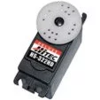
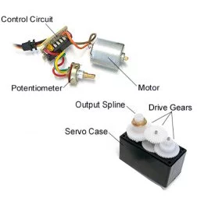
What is a Servo
Precise position control
0-180 Degree Rotation
Feedback Control
3 Wire Interface (Power, Ground, Angle [PWM])

Slide 4
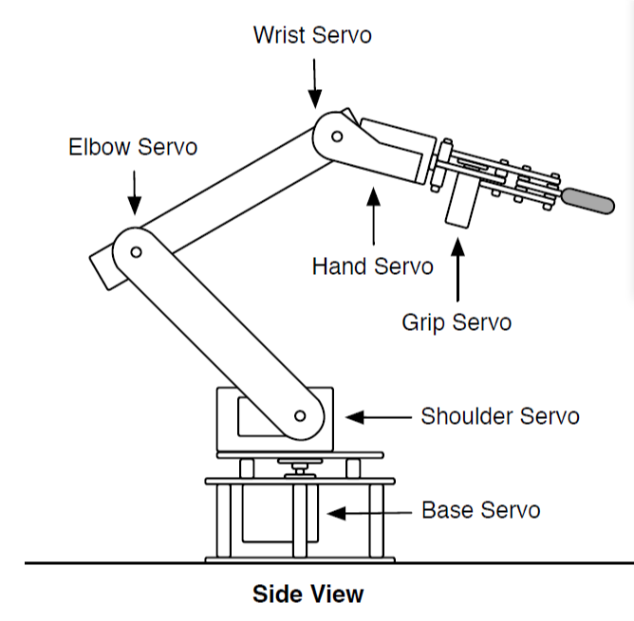
The Arm Servo Joints
Base Servo Rotates Z axis
Hand Servo Rotates the Gripper around its center line
Grip Servo Opens and Closes the Grip

Slide 5
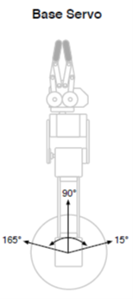
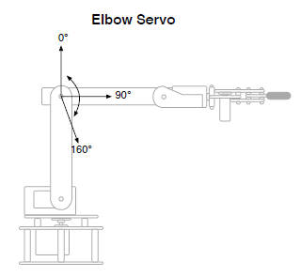
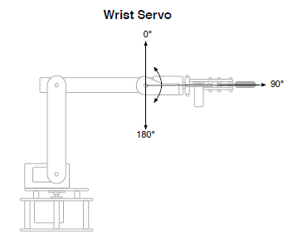
Range of Motion Base
180
90
0

Slide 6
DefiZnition of Arm space Z Axis
Z Axis is centered on the base axis
Z axis is referenced in degrees

Slide 7
Definition of Arm space X and Y
X axis is distance away from base center point
Y axis is Hight from base (positive and negative)
Y
X

Slide 8
Calculation of Joint angles
Kinematics Calculations give you a point for the tip of the gripper based on the joint angles
Reverse Kinematics give you the joint angles, based on the point of the tip of the gripper
Simplifying assumptions:
The gripper angle is defined with the end point (zero = parallel with ground)
The base angle calculation is left to the student

Slide 9
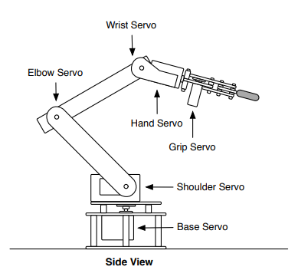
Reverse Kinematics Calculation Inputs
Inputs:
Desired Gripper tip point X,Y (given)
Base Angle (easy to calculate)
Height of base (constant)
Length of tibia (shoulder to elbow) (constant)
Length of forearm (elbow to wrist) (constant)
Length of gripper (wrist to Gripper tip point) (constant)
Angle of Gripper to ground (given)

Slide 10
Reverse Kinematics Calculation Outputs
Outputs
Base Angle
Shoulder Angle
Elbow Angle
Wrist Angle

Slide 11
Wrist Location Offset from Tip
X,Y
What we know:
Gripper tip point
Gripper length
Wrist-Gripper Angle
Solve for Wrist Offsets
XOffsetwrist = COS(Wrist Gripper angle)*Gripper Length
YOffsetwrist = SIN(Wrist Gripper angle)*Gripper Length

Slide 12
Wrist Location
Xwrist,Ywrist
What we know:
Wrist offsets to to Gripper tip
Base Height
Solve for Wrist position
Xwrist = X - Xoffsetwrist
Ywrist = Y - Yoffsetwrist - BaseHeight
X,Y

Slide 13
Calculation of Shoulder to Wrist Distance
Xwrist,Ywrist
What we know:
Xwrist, Ywrist
Solve for Shoulder to Wrist Distance
SWdistance = SQRT(Xwrist²+Ywrist²)
Shoulder to Wrist distance

Slide 14
Calculation of Shoulder to Wrist Angle With respect to ground
Xwrist,Ywrist
What we know:
Xwrist, Ywrist
Shoulder to Wrist Distance ( SWdistance)
Solve for Shoulder to Wrist Angle
A1 = ATAN2(Xwrist, Ywrist)
SWdistance

Slide 15
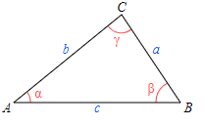
Law of Cosines
Law of Cosines used for computing the third side of a triangle when two sides and their enclosed angle are known
c² = a² + b² – 2ab cos C
cosC= (-c² + a² + b² )/2ab

Slide 16
Calculation of Shoulder to Elbow Angle
What we know:
Wrist Shoulder Distance (SWdistance)
Wrist to Elbow Distance (constant)
Elbow to Shoulder Distance (constant)
Solve for WristAngles
Acos(cosC)= Acos((-c² + a² + b² )/2ab)
A2=C= ACOS((-c² + a² + b² )/2ab)
c
b
C
a

Slide 17
Calculation of Shoulder Angle
What we know:
Shoulder to Wrist angle (A1)
Wrist to Elbow angle (A2)
Solve for Shoulder Angle
Shoulder Angle = A1 + A2
c
A2
A1
Shoulder angle

Slide 18
Calculation of Elbow Angle
What we know:
Wrist Shoulder Distance (SWdistance) (b)
Wrist to Elbow Distance (constant) (c)
Elbow to Shoulder Distance (constant) (a)
Solve for WristAngles
Acos(cosB)= Acos(( c² + a² - b² )/2ab)
Elbow Angle =B= ACOS(( c² + a² - b² )/2ab)
c
B
b
a

Slide 19
Calculation of Wrist Angle
What we know:
Shoulder Angle
Elbow angle
Gripper Angle
Solve for Wrist Angle
Wrist Angle = Gripper Angle– Elbow Angle – Shoulder Angle
Wrist Angle
c
A2
Shoulder angle
Gripper Angle

Slide 20
Offsets
Because the Servos center is at 90degrees, offsets must be added to the angles

Slide 21
Spreadsheet

Slide 22
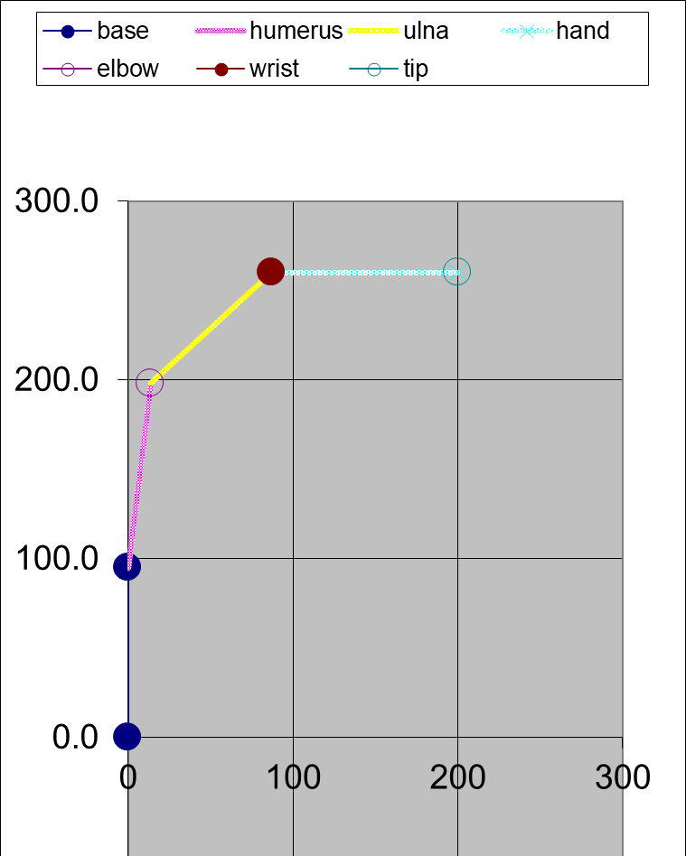
Simulation

